Slide 1
The Case for Defence
Graham Greene

Slide 2
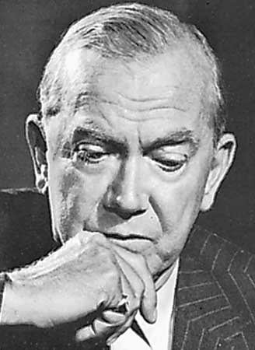

Slide 3
English novelist, short-story writer, playwright, and journalist whose novels treat life’s moral ambiguities in the context of contemporary Socio-political settings.

Slide 4
Characters
The narrator
The narrator is a reporter who is used to covering crime trials, yet he is astonished by a particular case which ended with an acquittal of a man who, by all evidence, appeared to be guilty.

Slide 5
The Adams twins
Though, at first, we do not know the accused has a twin brother, the two characters can be analyzed together, as they look the same and cannot be differentiated.
Adams is mostly depicted physically, but his traits are meant to reflect his evil character:

Slide 6
Mrs. Salmon
Mrs. Salmon is the main witness of the prosecution, the first to have seen the murderer flee Mrs Parker’s house and throw away a hammer. She is depicted with both sympathy and empathy by the narrator.

Slide 7
The Defence Counsellor
Though there are no descriptive words that could pinpoint the traits of the defence lawyer, we can still draw some conclusions about him based on the way he built his case and managed to get his client acquitted.

Slide 8
Theme and message
The main theme of the story “The Case for the Defence” by Graham Greene is earthly justice versus divine justice.
This theme is enhanced by motifs such as fear, uncertainty and capital punishment.

Slide 9
Earthly justice versus Divine justice
Earthly justice refers to the judicial systems people have implemented throughout history in order to punish crimes and maintain social stability and security. The story targets the justice system of the UK in the 1930s, a time when capital punishment was still used as a way to punish crimes.
The story clearly shows how defective the justice is and raises many dilemmas. Since capital punishment is the ultimate definitive sentence, passing a judgment becomes a delicate issue that needs to be dealt with caution.
...

Slide 10
Motifs
In the story, we can identify several motifs: fear, uncertainty and capital punishment.
The motif of fear is explored through Mrs. Salmon’s character. The woman was the key witness in a murder trial, yet the murderer got away. Given these circumstances, her sense of fear is natural and is actually caused by uncertainty. She cannot possibly know if the real murder died or if it was the innocent brother who got killed by the bus:
“I talked afterwards to Mrs. Salmon, who naturally after the astonishing verdict went in fear herself.”

